Slide 1
Money Super Market Technology
Pete Hanlon & Chris Owen

Slide 2
Introduction
Where’s Pete?
Moneysupermarket.com
The Reset Project
The Story So Far
Technologies
Dev Ops
What’s Next

Slide 3















































Core Technology
Collaboration
Content Management
Data & Insight
Network Services
Code Repositories
Frameworks
Hosting
Digital Marketing
Dropwizard
Build Tools
Web Facing Data
Platform
Email Campaign
Graphite
Testing & Integration
Languages
Activity Insight
Deployment

Slide 4
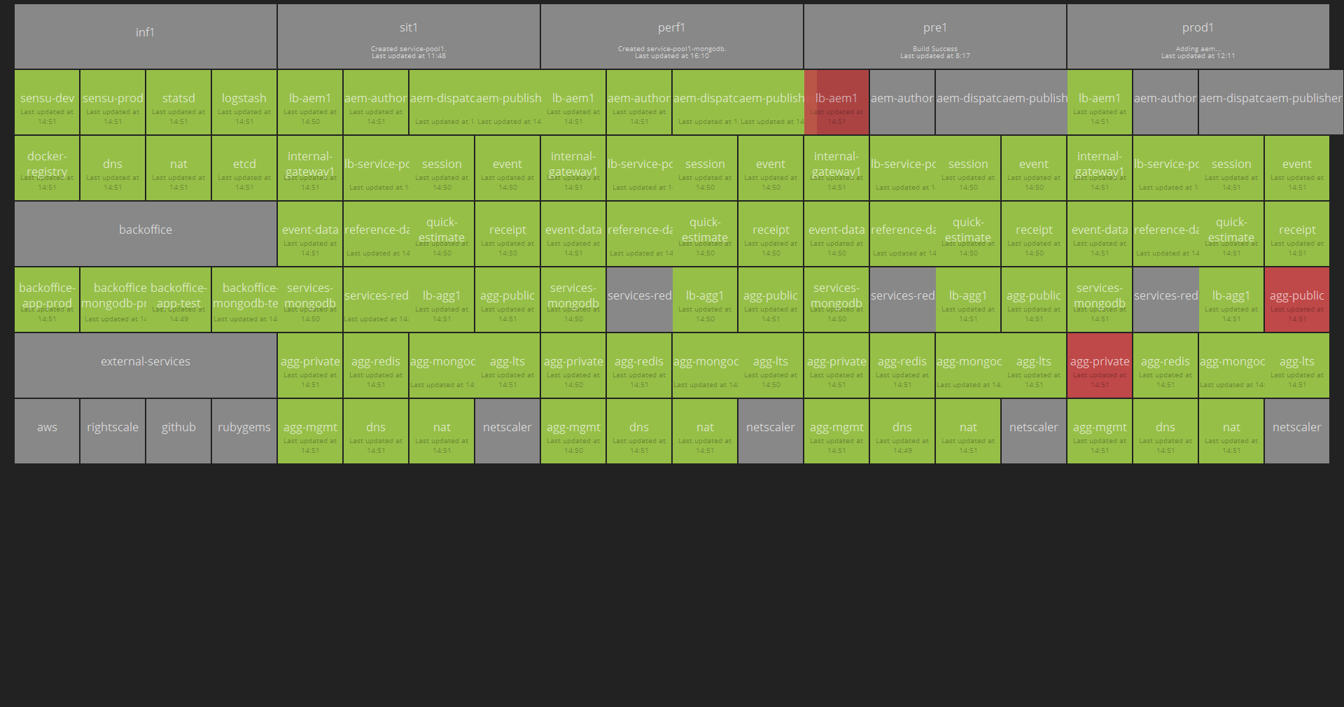
Environment Dashboard

Slide 5
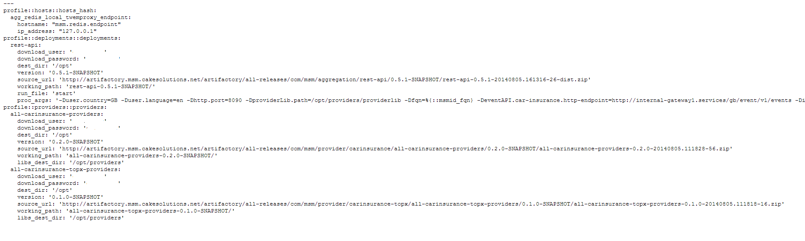
Puppet & Hiera
Hiera Snapshot

Slide 6
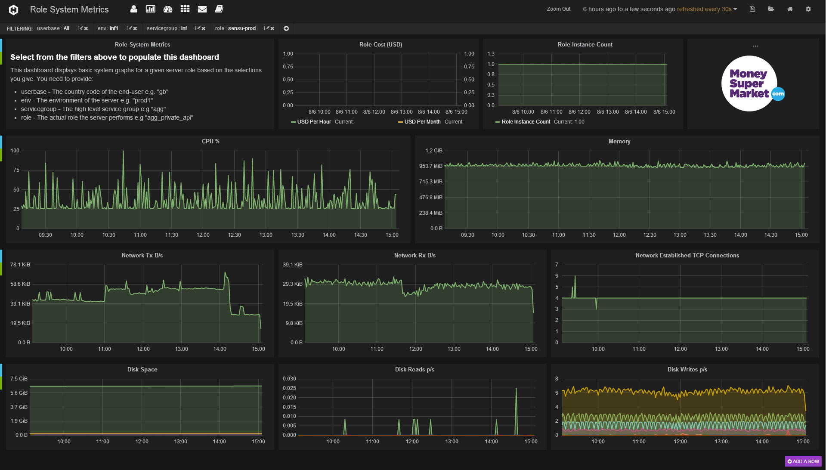
Metrics & Monitoring - Grafana

Slide 7
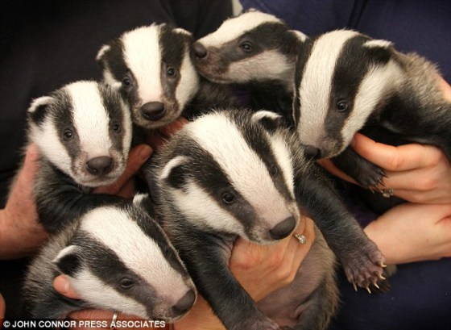
Chaos Monkey…..Sort Of

Slide 8
About Me
Chris.owen@moneysupermarket.com

